Slide 1

DON’T. PANIC.
By Nicholas R. Smith
Notes:
Hello there! I hope you all are doing well. Or, at least as well as you can be one week from finals.
I know this is a stressful time of year for you all, and I’m hoping this presentation can be a source of consolation and hope during this stressful time
I’m going to be talking a little bit about who I am, more about who my company is and what we do, and then we’re going to shift the focus back to you guys and where you’re at in your budding careers
I also am looking forward to sharing some nuggets of wisdom with you, things that I wish I had learned earlier.
And at the end, in the interest of remaining open source, I have a QR code to access these slides. All of the statistics you see, I have made sure to fact check and provide the sources for.
There will also be a QR code at the end to access my company’s career page. SEL is looking to hire and is looking for interns. It’s always a good time to submit your resume.
I just want to say that I owe a great debt to GU and this wonderful community and it is my privilege to visit you all and offer something back. I also thank you for your time, and I don’t take that for granted.

Slide 2
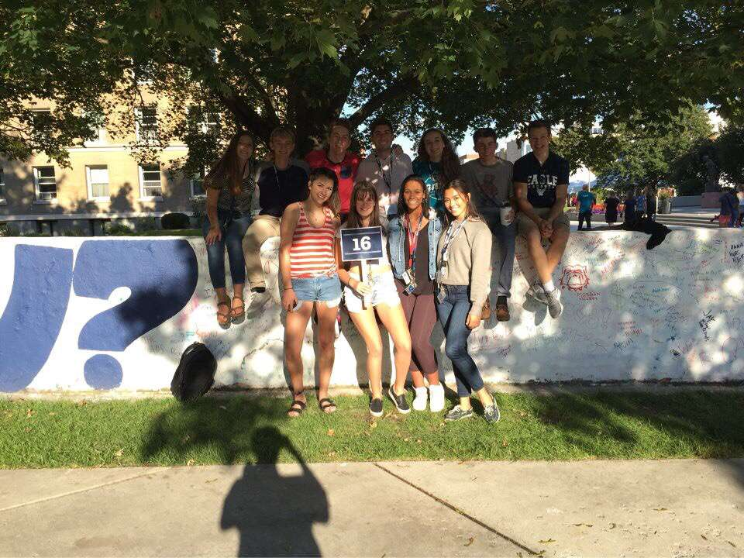
Who am I?
Notes:
So, a little bit about myself and my background
Grew up in Pullman, just 90 minutes south of Spokane
Came to GU in the fall of 2018 and graduated from Gonzaga last May
Personally indebted to this community. I was raised Catholic but fell away for many years. It was a long process, but I rediscovered my faith at GU and actually was confirmed in the Catholic Church at St. Al’s this Easter.
I love to backpack and travel and actually got a chance to travel to Europe this January and visit a friend in Edinburgh as well as visit old friends in Madrid from when I studied abroad there three years ago

Slide 3
Notes:
Me! At the WSU Hackathon in 2016
Anecdote about learning ActionScript as my first programming language

Slide 4




Notes:
I work at Schweitzer Engineering Laboratories, headquartered in Pullman. Go cougs!
Been in business since the late 70s. We mainly make relays, fancy switches designed to protect very, very expensive equipment in the power grid
My anecdote about not wanting to go back to Pullman and starting off as a hater and literally telling my boss that I wasn’t convinced that SEL wasn’t evil
Now, I love what I do. I love my coworkers, I have immense job satisfaction and take pride in the code I write. Also, I am now confident that SEL isn’t evil

Slide 5
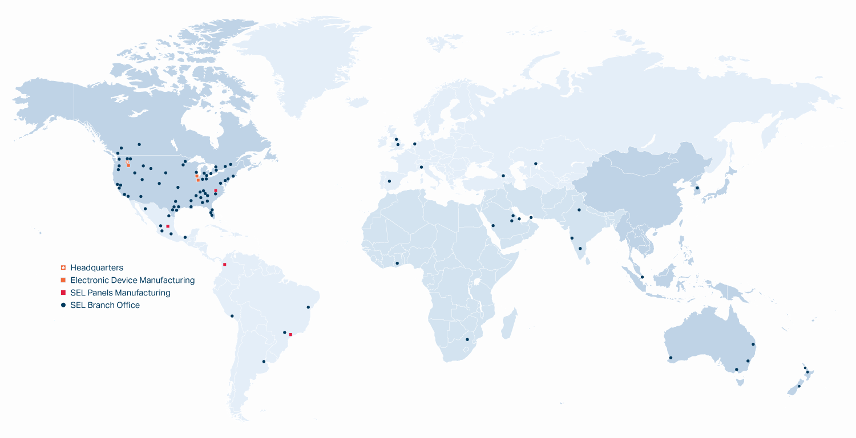
Notes:
At one time I thought SEL was just a Pullman operation, but it truly has international outreach. I actually visited our Madrid office in January while I was there on vacation
SEL is a billion dollar company, but we employee owned, meaning that I and my coworkers are the shareholders and share in the profits, not Wall Street. It also means the more money I make for SEL, the more goes back into my own back pocket, which is nice :)

Slide 6
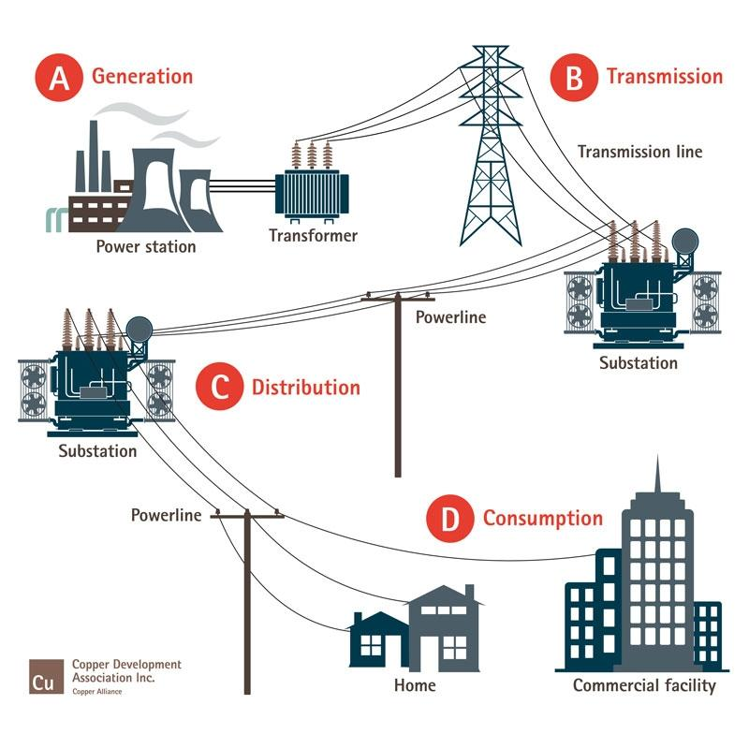
The Power Grid
Notes:
This system works great on a normal day, but when something goes wrong, it can go very wrong

Slide 7
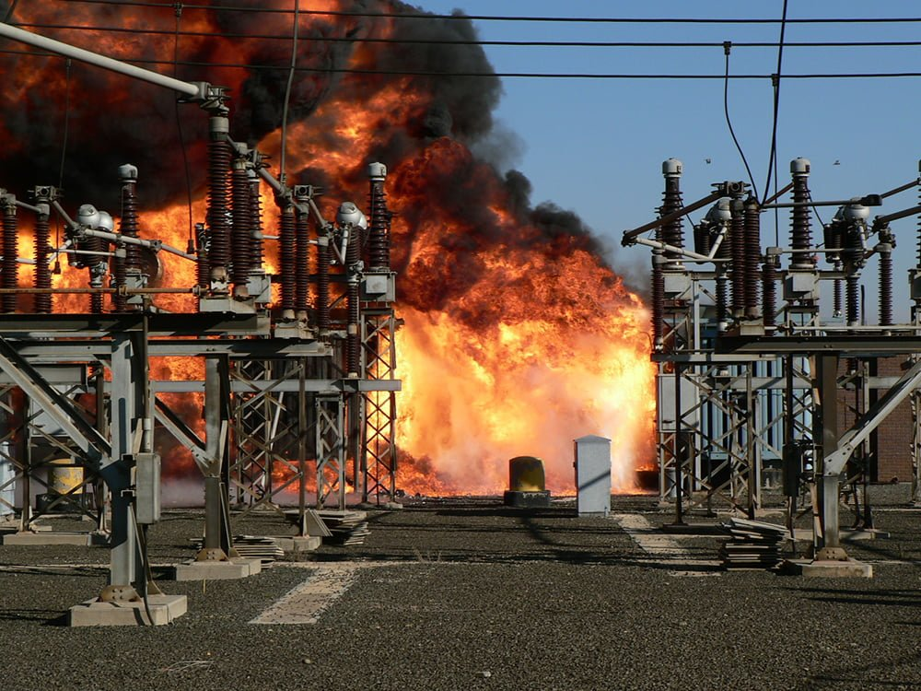

Slide 8
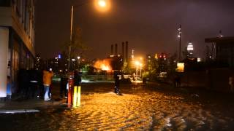
Notes:
Williamsburg Waterfront in Brooklyn
9PM during hurricane Sandy in the fall of 2012
Watch the lights on the power plant go out after the explosion

Slide 9
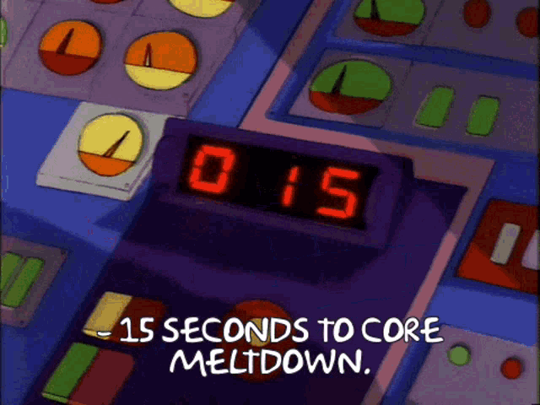

Slide 10

California Forest Fires
Pacific Gas & Electric (PG&E) responsible for sparking “at least 1,500 California fires”¹
PG&E equipment “started more than one fire a day in California on average in recent years”¹
Responsible for the Dixie Fire, the “second largest fire in California’s history”²
1. Gold, R., Blunt, K., & Smith, R. (2019, February 28). PG&E sparked at least 1,500 California fires. now the utility faces collapse. The Wall Street Journal. Retrieved April 29, 2023, from https://www.wsj.com/articles/pg-e-sparked-at-least-1-500-california-fires-now-the-utility-faces-collapse-11547410768
2. Newburger, E. (2022, January 5). California finds PG&E equipment responsible for massive Dixie Fire. CNBC. Retrieved April 29, 2023, from https://www.cnbc.com/2022/01/05/california-finds-pge-equipment-responsible-for-massive-dixie-fire-.html
Notes:
I wanted to highlight the California Forest Fires because it is an extreme example of how poorly things can go wrong
It’s also an example of how engineering can solve real problems, even save lives
In the last two years, PG&E has plead guilty to 84 counts of manslaughter for the lives lost in preventable forest fires of which PG&E failed to prevent and then tried to cover up

Slide 11
https://video.selinc.com/detail/videos/solutions/video/1760467218219293040/falling-conductor-mitigation-demonstration?autoStart=true
Notes:
Not all problems have an engineering answer, but this one does. Thanks to a technology called falling conductor technology that SEL has developed, we can entirely prevent utility caused forest fires from occuring at all.
PMU = Phasor Measurement Unit, measures voltage and current amplitude and phases
I had the privilege and responsibility of writing new firmware for the RTAC, this device that takes in data from the PMUs and make the decision to trip the breaker

Slide 12
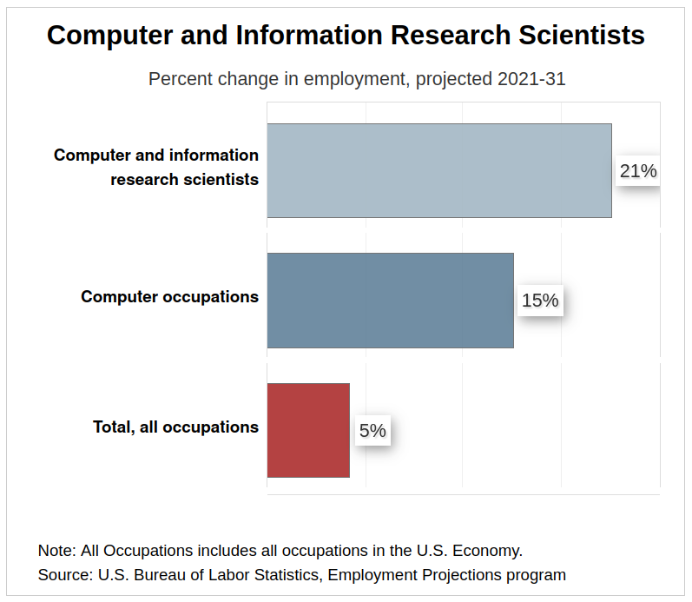
21% increase
Bureau of Labor Statistics, U.S. Department of Labor, Occupational Outlook Handbook, Computer and Information Research Scientists, visited (March 20, 2023) at https://www.bls.gov/ooh/computer-and-information-technology/computer-and-information-research-scientists.htm
Notes:
So that’s SEL, and that’s a bit about what we do and what I’m apart of. Now, I’d like to shift the focus to you all and where you’re at

Slide 13
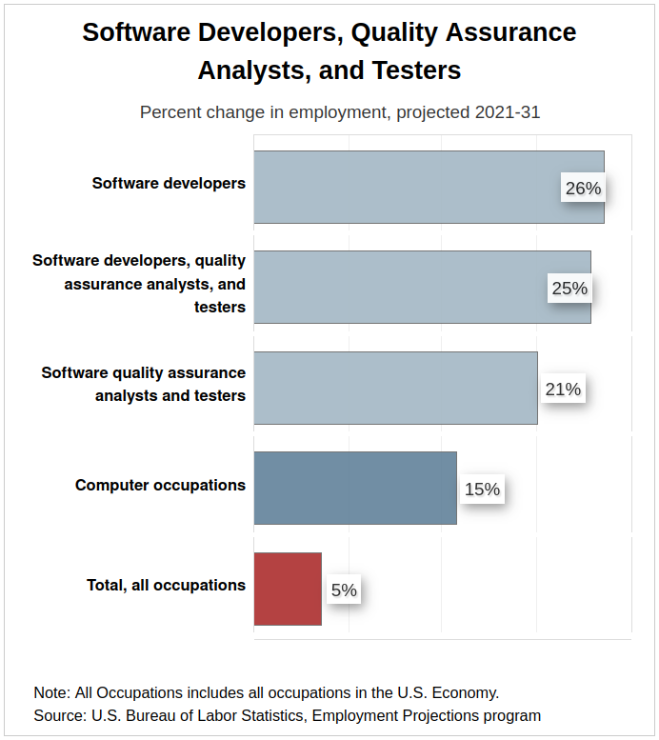
26% increase
Bureau of Labor Statistics, U.S. Department of Labor, Occupational Outlook Handbook, Software Developers, Quality Assurance Analysts, and Testers, visited (April 22, 2023) at https://www.bls.gov/ooh/computer-and-information-technology/software-developers.htm

Slide 14
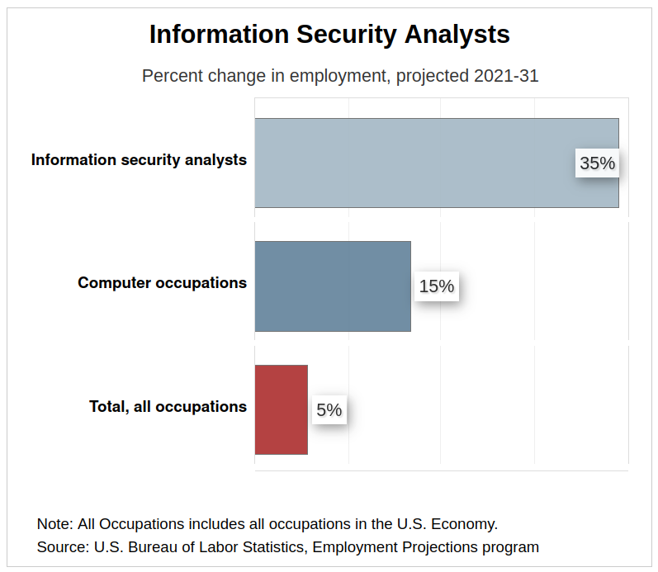
35% increase
Bureau of Labor Statistics, U.S. Department of Labor, Occupational Outlook Handbook, Information Security Analysts, visite ((visited April 12, 2023) at https://www.bls.gov/ooh/computer-and-information-technology/information-security-analysts.htm
Notes:
A software engineer to a information security analyst is like a writer to an editor. Both are necessary to produce something high quality, but their roles are different

Slide 15
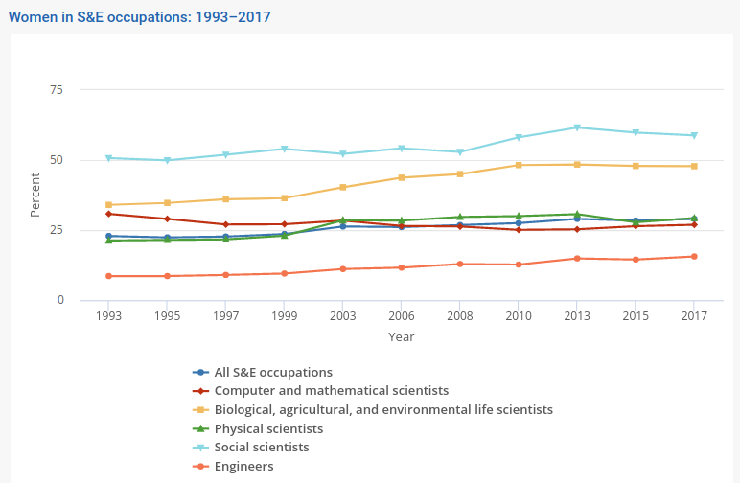
National Science Board, National Science Foundation. 2019. Science and Engineering Indicators 2020: Science and Engineering Labor Force. Science and Engineering Indicators 2020. NSB-2019-8. Alexandria, VA. Available at https://ncses.nsf.gov/pubs/nsb20198/.
Notes:
According to Department of Labor Bureau of Labor Statistics, approximately 26% of all computing workforce jobs were occupied by women in 2021

Slide 16

331% increase in girls taking CS AP exams in 2016
College Board AP Program Summary Report, 2016, 2021
Notes:
This is by far the most uplifting statistic I have found on the disparity between male and female software engineers
Women still only represent 25% of software engineers, but it’s statistics like these that lead me to believe we are at least heading in the right direction

Slide 17
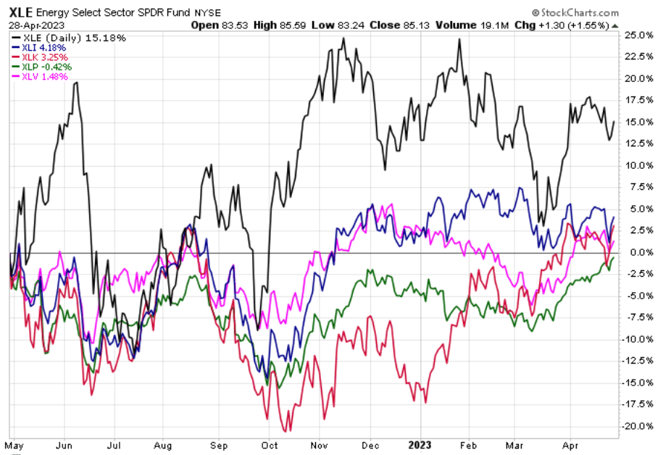
Energy Sector
Industrial Sector
Health Care Sector
Consumer Staples
Technology Sector
Notes:
XLE = Energy Sector Fund
XLI = Industrial Sector Fund
XLK = Technology Sector Fund
XLP = Consumer Staples Sector Fund
XLV = Health Care Sector Fund

Slide 18
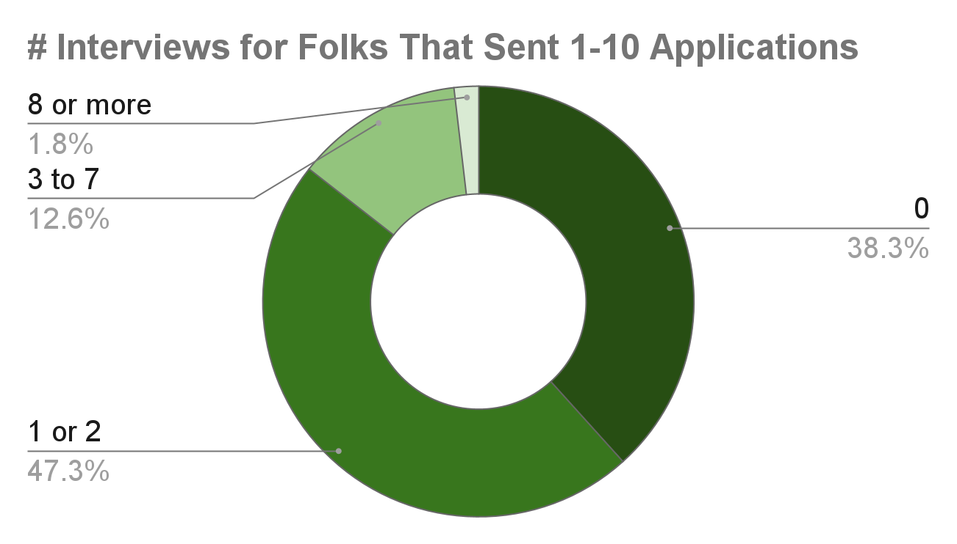
Michael R. Dalton and Jeffrey A. Groen, “How do jobseekers search for jobs? New data on applications, interviews, and job offers,” Beyond the Numbers: Employment & Unemployment, vol. 9, no. 14 (U.S. Bureau of Labor Statistics, November 2020), https://www.bls.gov/opub/btn/volume-9/how-do-jobseekers-search-for-jobs.htm
Notes:
These statistics come from a study done by the US Bureau of Labor Statistics in 2018
Keep in mind too that these statistics are for all occupations, not just software engineers. Your mileage may vary :)

Slide 19
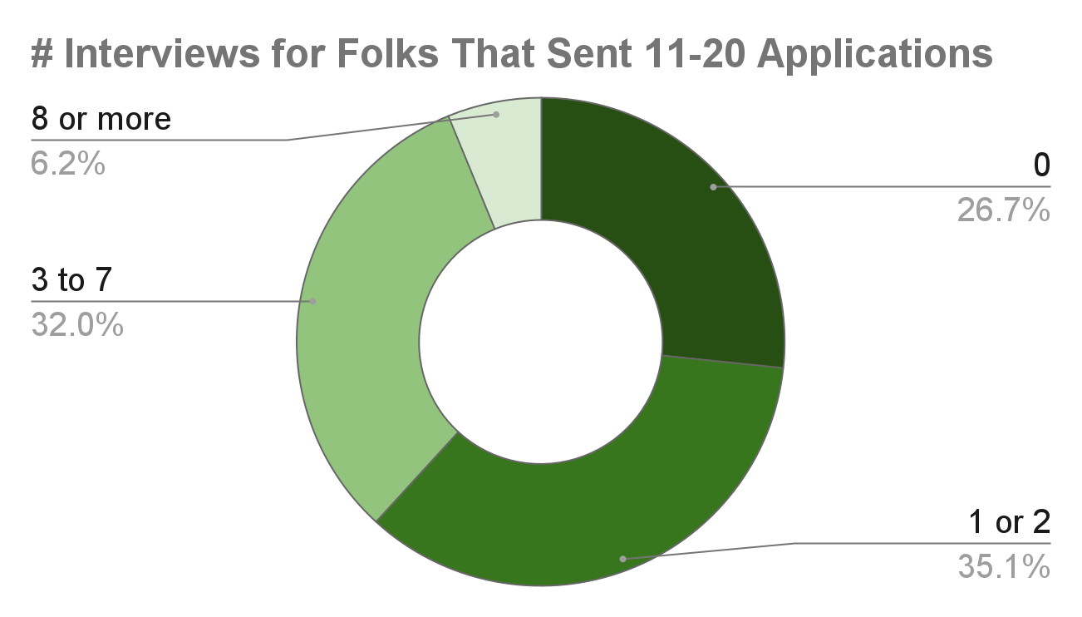
Michael R. Dalton and Jeffrey A. Groen, “How do jobseekers search for jobs? New data on applications, interviews, and job offers,” Beyond the Numbers: Employment & Unemployment, vol. 9, no. 14 (U.S. Bureau of Labor Statistics, November 2020), https://www.bls.gov/opub/btn/volume-9/how-do-jobseekers-search-for-jobs.htm

Slide 20
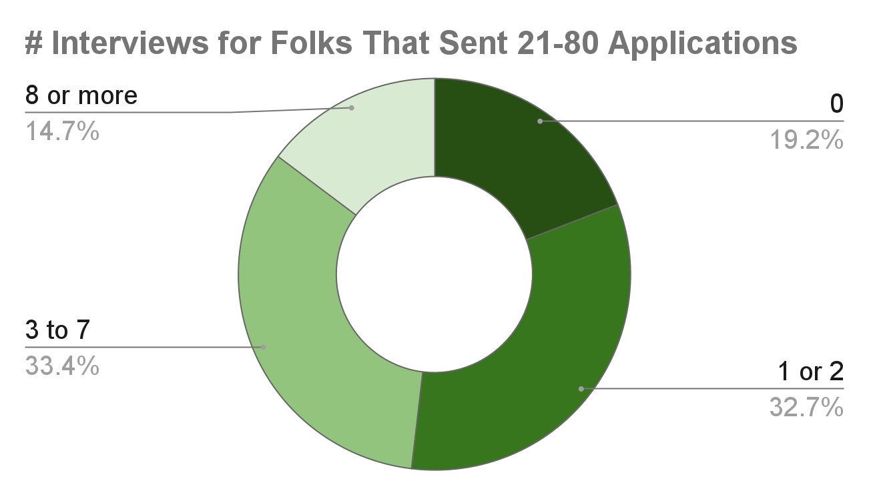
Michael R. Dalton and Jeffrey A. Groen, “How do jobseekers search for jobs? New data on applications, interviews, and job offers,” Beyond the Numbers: Employment & Unemployment, vol. 9, no. 14 (U.S. Bureau of Labor Statistics, November 2020), https://www.bls.gov/opub/btn/volume-9/how-do-jobseekers-search-for-jobs.htm

Slide 21
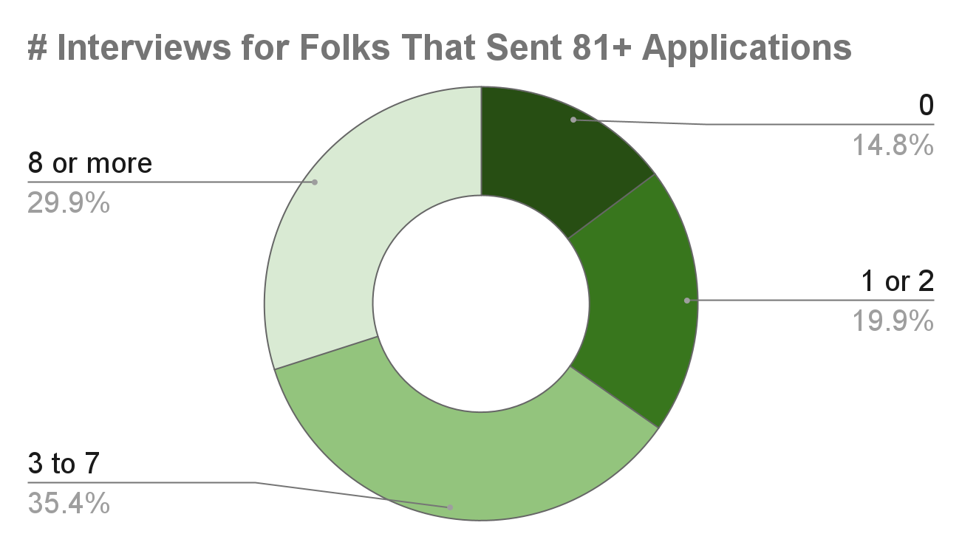
Michael R. Dalton and Jeffrey A. Groen, “How do jobseekers search for jobs? New data on applications, interviews, and job offers,” Beyond the Numbers: Employment & Unemployment, vol. 9, no. 14 (U.S. Bureau of Labor Statistics, November 2020), https://www.bls.gov/opub/btn/volume-9/how-do-jobseekers-search-for-jobs.htm
Notes:
The lesson here is, job applications are like lottery tickets. The more applications you put out, the better chance you have of getting an interview
Internship / job applications are also like college apps. You should have reach jobs, safety jobs, and everything inbetween that you are applying for

Slide 22
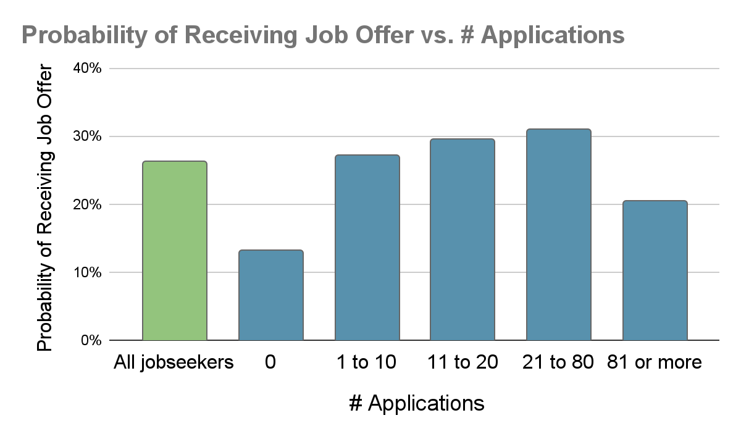
Michael R. Dalton and Jeffrey A. Groen, “How do jobseekers search for jobs? New data on applications, interviews, and job offers,” Beyond the Numbers: Employment & Unemployment, vol. 9, no. 14 (U.S. Bureau of Labor Statistics, November 2020), https://www.bls.gov/opub/btn/volume-9/how-do-jobseekers-search-for-jobs.htm
Notes:
The lesson here is that, well before you find yourself sending out 81 applications, schedule a meeting with career and professional development. They are literally paid to help you find a job

Slide 23
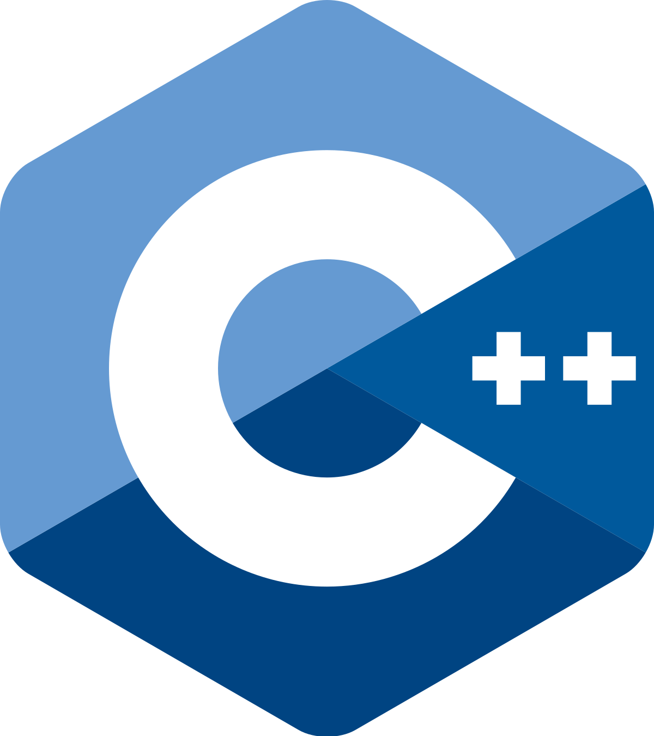


(Paid) Work I’ve Done So Far
5 months embedded C++
5 months Golang
GTK 3.0 for GUI design
kubernetes
Bash scripting CI/CD tools
Jenkins
(Learning) Rust

Slide 24
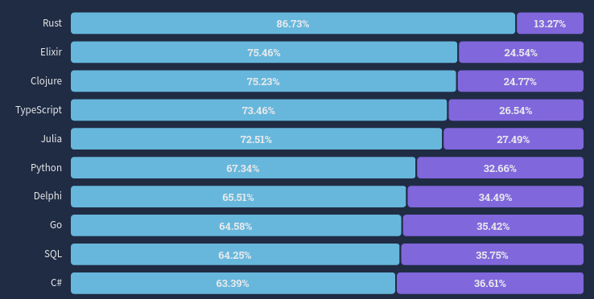
Stackoverflow 2022 Survey: https://survey.stackoverflow.co/2022/?utm_source=thenewstack&utm_medium=website&utm_content=inline-mention&utm_campaign=platform#section-most-loved-dreaded-and-wanted-programming-scripting-and-markup-languages
Notes:
Loved in blue, dreaded in purple
Note that C++ was ranked 25. Note that there is generally a correlation between how new a language is and how well liked that language is, so take these results with a grain of salt

Slide 25
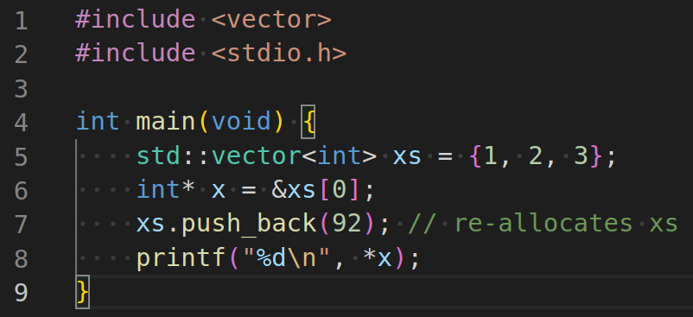
Notes:
And I didn’t want to end today without showing you a little code, so here is a very simple program pushing a new integer to a standard vector.
Can anyone spot the bug?

Slide 26
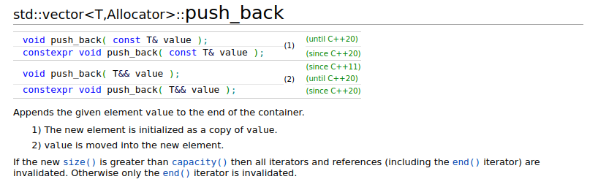
Source: C++ Reference, “std::vector<T,Allocator>::push_back”. Accessed May 1, 2023. Retrieved from https://en.cppreference.com/w/cpp/container/vector/push_back

Slide 27
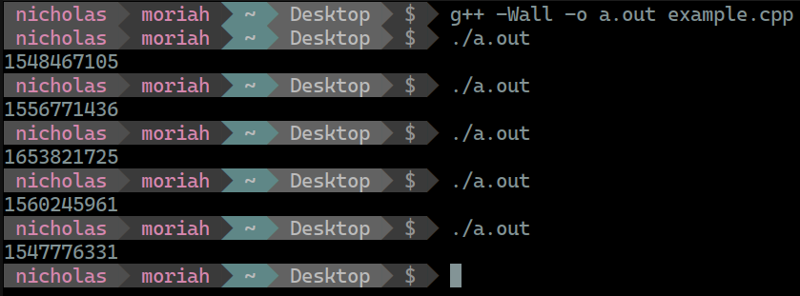

Slide 28
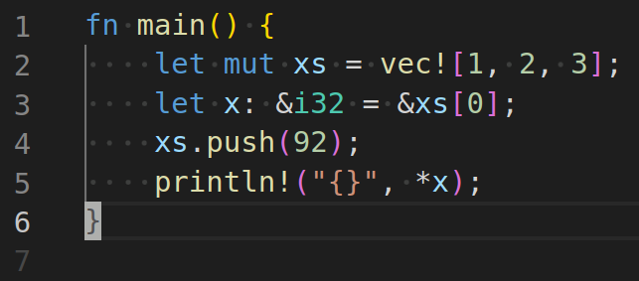

Slide 29
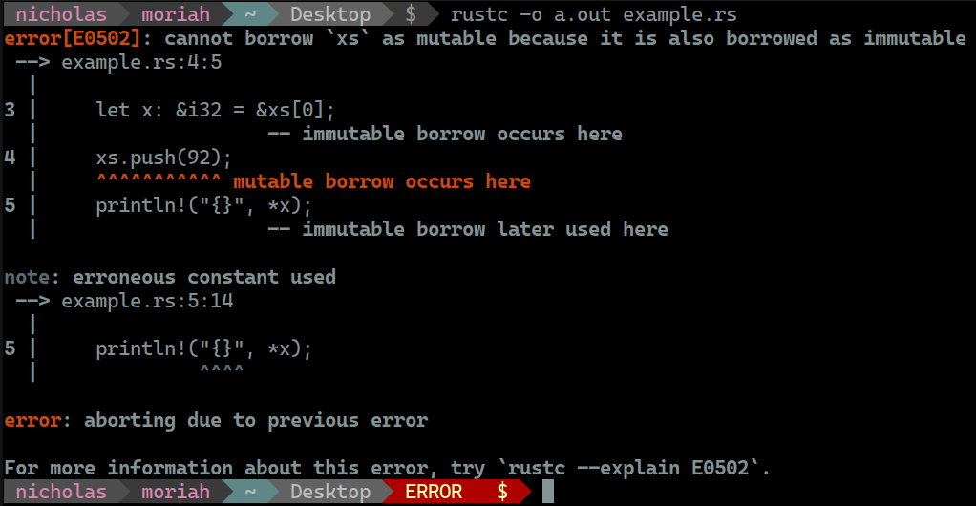

Slide 30



How To Get Good.
git
personal projects
passion
Version control system used by almost every company doing software development
GitHub is your friend
New ideas or building off the ideas of others
Don’t just do something because it’s a resume builder, do it because you love it!
Notes:
Learn about interfaces
Learn about mocking and code coverage tools for unit testing
Documentation is so important. Mermaid diagrams and draw.io are an amazing way to create communicate higher level design concepts quickly

Slide 31


Thank you!!!
SEL Careers Website:
QR Code for Slides:
Notes:
Thank you all for your time. I hope this presentation has given a number of reasons not to panic as the finals and the summer approach. I’d be happy to take take any remaining questions

